Slide 1
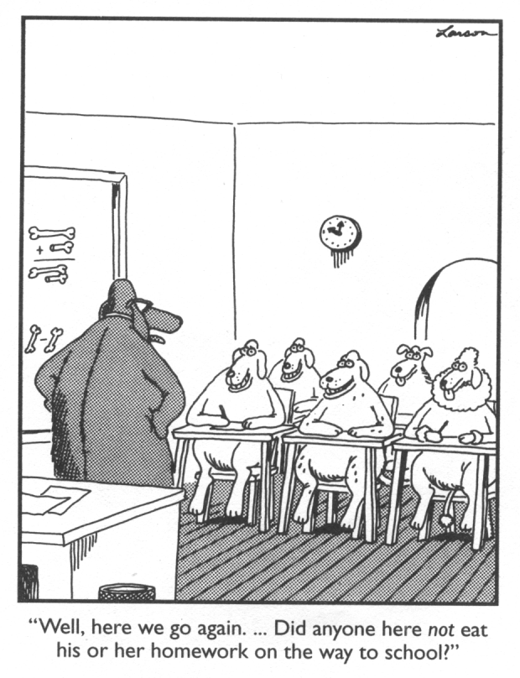
Energy in a Reaction

Slide 2
Reaction Rates Depend On:
Rate of collisions (More collisions = faster rxn)
Effectiveness of collisions (angle of collisions)
Nature of reactants
Ionic (inorganic) compounds form faster than covalent (organic) compounds.
Ionic: no bonds need to be broken
Alkali metals = highly reactive
Alkali Metal Youtube Video

Slide 3
Evidence of a Reaction
Change in color
Change in temperature
Bubbles, odor
Precipitate
Change in concentrations

Slide 4
Energy in a Reaction
Activation Energy:
The energy needed to get a reaction going.
Bonds need to be broken for rxn to begin.
Activation Energy

Slide 5
A common analogy is pushing a boulder over a hill. Actually over a "pass" . The reactants are on one side like the boulder. The energy needed to push the boulder to the crest of the hill is like the activation energy. The products are like the condition when the boulder is at the bottom of the far side of the "pass".

Slide 6
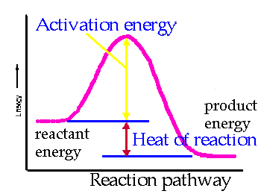

Slide 7
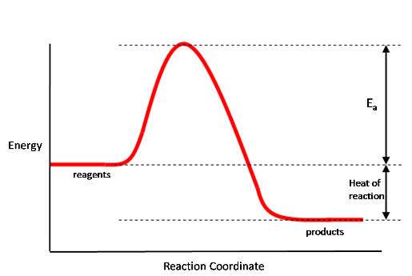
Energy in a Reaction
Heat of Reaction: ∆H
the difference in energy between the products and reactants.
∆H = energy of products – energy of reactants
Energy of Reactants
∆H
Energy of Products

Slide 8
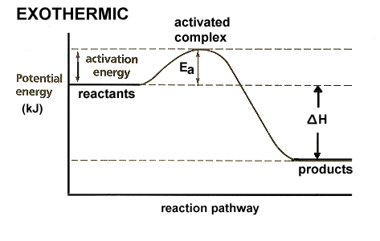
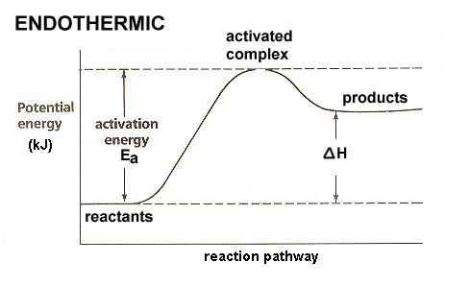
Heat of Reaction
Reference Table I
∆H is negative for exothermic reactions.
∆H is positive for endothermic reactions.
Exothermic –
gives off heat (-∆H)
Endothermic – absorbs heat (+∆H)

Slide 9
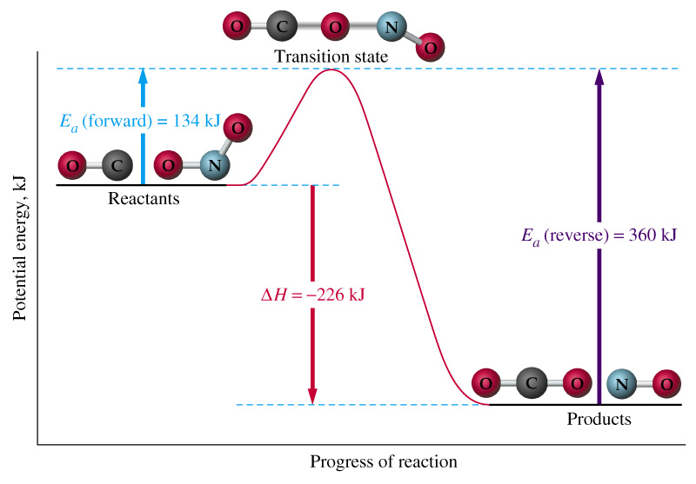
Reverse Reaction
*Going from right to left
Reverse = Endothermic
Forward =
Exothermic

Slide 10
Reverse Reaction
Forward rxn:
Smaller Activation Energy
Reverse rxn:
Higher Activation Energy

Slide 11
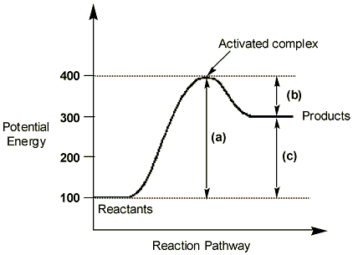
Activated Complex
Transition between reactants and products
Peak of the energy curve

Slide 12
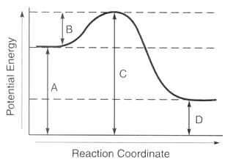
A = Potential Energy of Reactants
B = Activation Energy
C = Potential Energy of Activated Complex
D = Potential Energy of Products
E = ∆H or Heat of Reaction
E

Slide 13
Exothermic vs. Endothermic Song Youtube Video

