Slide 1
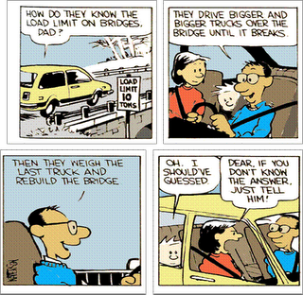
Reaction Rates

Slide 2
Reaction Rate Activity
H₂O₂ + Yeast → ?
Create a before and after table on a piece of paper to record your observations.
Pour about 10mL of hydrogen peroxide into a small beaker and observe.
Add a small spatula of yeast to the hydrogen peroxide. Stir gently with a stirrer and observe.
Light a wood splint and test for the presence of oxygen.

Slide 3
Into what two products does the hydrogen peroxide decompose?
O₂ and H₂O
Why weren’t bubbles produced in step 2?
What is the function of the yeast?
The yeast acts as a catalyst which speeds up the chemical reaction.

Slide 4
Rates of Reaction
The rate of a chemical reaction is the speed with which reactants are converted to products.
Change in concentration over time.
Rate = ∆M
∆t

Slide 5
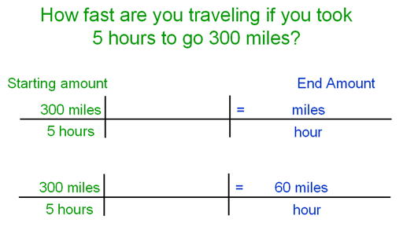
Comparison to miles/hour

Slide 6
Collision Theory
Collision Theory is used to explain why chemical reactions occur at different rates.
Particles need to collide to react.
*More collisions = faster reaction

Slide 7
2. The higher the concentration of particles, the faster the reaction.
*Due to increased collisions.

Slide 8
Particles must collide with sufficient energy to break any bonds in the reactant particles.
*The activation energy is the minimum amount of energy the colliding reactant particles must have in order for products to form.

Slide 9
4. Particles must hit at the right orientation.
Ineffective Collision
Effective Collision

