Slide 1
Molarity
We all need practice!

Slide 2
Molarity
Molarity (M) or molar concentration is a measure of the concentration of a solute in a solution.
Unit for molar concentration is mol/L.
Molarity (M)= Moles of Solute
Liters of Solution

Slide 3
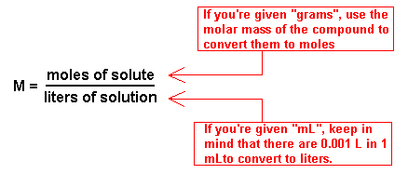
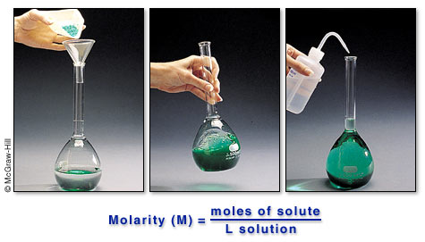

Slide 4
What is the molarity of a solution that has 0.90g NaCl in 100. mL solution?
Step 1: Convert g → mol
1 mol
58g
0.90g X
= 0.016 mol
Step 2: Convert mL → L
1 L
1000mL
100.mL X
= 0.100L
Step 3: Use Molarity Formula
0.016 mol
0.100L
= 0.16 M

Slide 5
How many moles of NaOH are contained in 200mL of 0.25 M NaOH?
mol
L
M =
X mol
0.2L
0.25 M =
X = 0.05 mol

Slide 6
How many moles of solute are in 1.5L of 0.70M NaCl?
mol
L
M =
X mol
1.5L
0.70 M =
X = 1.1 mol NaCl

Slide 7
Learning Check
Calculate the molarity of a solution containing 400. g CuSO4 in 4.00 L of solution.
0.627 M

Slide 8
Learning Check
What is the molarity of a solution containing 20 grams of NaOH in 500 milliliters of solution?
1 M

Slide 9
Learning Check
What is the molarity of a solution of NaOH if 2 liters of the solution contain 4 moles of NaOH?
2 M

