Slide 1
Finding Molecular Formulas

Slide 2
HW – Ques. 7.5
To the nearest whole number what is the percent by mass of water in Ba(OH)₂·8H₂O?

Slide 3
HW – Ques. 7.6
Find the empirical formula of the following compounds:
H₂0₂
C₇H₁₂
C₆H₆

Slide 4
HW – Ques. 7.7
Find the empirical formula of the following compounds that contain:
75% C, 25% H
40% Ca, 12% C, 48% O

Slide 5
HW – Ques. 7.8
Find the empirical formula for the following compounds that contain:
1.8g Ca, 3.2g Cl
8.8g Cs, 2.35g Cl

Slide 6
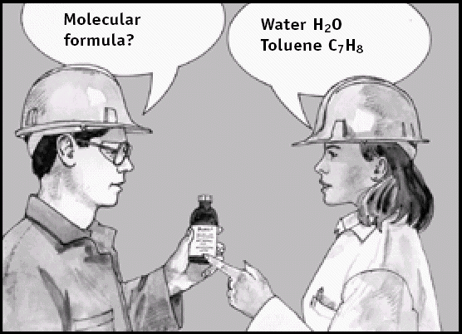
Review
Empirical formulas give the lowest whole number ratio of the atoms in a compound.
Molecular formulas gives the exact composition of one molecule.

Slide 7
Empirical formulas can be calculated using experimental data:
Given that a certain compound is 69.58% Ba, 6.090% C and 24.32% O, calculate the empirical formula of this compound.
Assume that you have 100.00 g of the compound:
69.58% Ba = 69.58 g Ba
6.090% C = 6.090 g C
24.32% O = 24.32 g O
Convert the mass of each element to moles of that element: Ba = (69.58 g Ba)(1 mol Ba/137.3 g Ba) = 0.5068 mol Ba C = (6.090 g C)(1 mol C/12.01 g C) = 0.5071 mol C O = (24.32 g O)(1 mol O/16.00 g O) = 1.520 mol O
Divide through each value by the smallest number of moles to get a 1 : 1.001 : 2.999 ratio, which rounds of nicely to give the formula BaCO₃

Slide 8
Finding Molecular Formulas
1st – find the empirical formula using % composition as described in previous slide.
2nd – find the formula mass from the empirical formula.
3rd – divide the molar mass (molecular mass) by the formula mass.
4th – multiply each of the subscripts in the empirical formula by the answer in step 3.

Slide 9
Molecular Formula
Oxalic acid has empirical formula HCO₂ and molar mass of 90g. What is the molecular formula?
1st – formula mass of HCO₂ =
45g
2nd – divide molar mass by formula mass:
90g/45g = 2
Answer – molecular formula is 2X the empirical formula so HCO₂ →
H₂C₂O₄

Slide 10
What is the molecular formula for a substance with 65.45% C, 5.45% H, 29.09% O with a molar mass of 110g/mol?
1 mol
12g
C
H
O
3X12=36
3X1= 3
1X16= 16
55
65.45g C
X
= 5.45 mol C
5.45g H
1 mol
1g
= 5.45 mol H
X
1 mol
16g
= 1.82 mol O
110
55
29.09g O
X
= 2X
C H O
Empirical = C₃H₃O
5.45
1.82
5.45
1.82
1.82
1.82
Molecular = C₆H₆O₂

Slide 11
Flowchart
% composition
factor
Molecular
Formula
Assume100g
sample
Empirical Formula
Grams of each element
Calculate mole ratio
moles of each element
Use atomic weights

Slide 12
Learning Check:
Substance is 46.68% N and 53.32% O.
Molar mass = 90.01g/mol
46.68g N
1 mol
14g
X
= 3.33 mol N
53.32g O
1 mol
16g
X
= 3.33 mol O
N O
3.33
3.33
3.33
3.33
NO
Molecular = N₃O₃
N
O
1X14= 14
1X16= 16
30
90
30
= 3X

