Slide 1
Gay-Lussac – HW Review
1.30 A tank contains oxygen at STP. If the Kelvin temperature of the gas is doubled, what is the new pressure of the gas?

Slide 2
Combined Gas Law - HW Review
1.31 At a temperature of 300. K and a pressure of 2.0 atm, a gas has a volume of 240 mL. If the temperature is increased to 400. K, and the new pressure is 4.0 atm, what is the new volume of the gas?

Slide 3
Combined Gas Law – HW Review
1.32 A gas has a volume of 25.0 L at a temperature of 27°C and a pressure of 1.00 atm. The gas is allowed to expand to a new volume of 50.0 L. The pressure is now 0.40 atm. What is the final temperature?

Slide 4
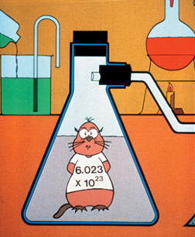
Avogadro’s Hypothesis
Equal volumes of gases at the same temperature and pressure have the same number of molecules.

Slide 5
Avogadro’s Hypothesis
Mole is used to count very small particles.
A mole is a basic unit of the amount or quantity of a substance. It may be atoms, molecules, ions or group of ions.
For example, if equal volumes of different gases like hydrogen, oxygen and chlorine are held in separate containers under similar conditions of temperature and pressure, then each container will contain the same number of molecules.

Slide 6
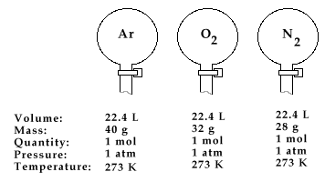
Avogadro’s Number
1 mol = 6.02 X 10²³
1 mole of any gas at STP has a volume of 22.4 L
Known as Molar Volume.

Slide 7
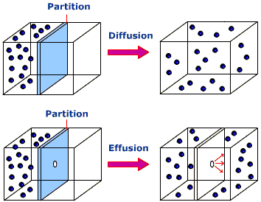
Diffusion of Gases:

Slide 8
Graham’s Law
Inverse Relationship – lighter gases diffuse faster than heavier gases at the same temperature.
Graham's law is useful in:
Separation of gases having different densities by diffusion.
Determining the densities and molecular masses of unknown gases by comparing their rates of diffusion with known gases.
Separating the isotopes of some of the elements.

Slide 9
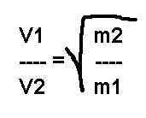
Graham’s Law
At equal temperatures:
KE _{gas 1} = KE _{gas 2}
KE₁ = KE₂
KE = 1/2MV²
Therefore:
1/2m₁V₁² = 1/2m₂V₂²
m₁V₁² = m₂V₂²
m₁V₂² m₁V₂²

Slide 10
Text Book
Please look at Sample Problem on page 40 and 41.

Slide 11
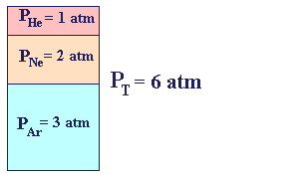
Dalton’s Law of Partial Pressure
At constant temperature, the pressure of a mixture of gases, equals the sum of the partial pressures of the gases in the mixture.
P₁ + P₂ + P₃ = P_{Total}

Slide 12
Learning Check
1 mol H₂
3 mol O₂
P = 40 kPa
P_{H2} =
P_{O2} =

Slide 13
Deviation from Gas Laws
When gas molecules are close together, deviations from the gas laws occur.
Real vs. Ideal Gases
Ideal Gas | Real Gas
*No Attractions | *Some Attractions
*Negligible Particle Size | *Some Particle Volume

Slide 14
Under what conditions will attractive forces be the least?
Pressure – Low
Temperature – High
More Ideal Gas → PV Works!
T
High pressure and low temperature will cause a gas to liquify → PV Doesn’t Work
T

Slide 15
Ideal Gas
 | Low | High
Temp. |  | X
Pressure | X
Polarity | X
Weight | X

Slide 16
Which gas would deviate more from the ideal gas law?
He or Rn
He has 4 amu
Rn has 222 amu
At the same temp: KE_{He} = KE_{Rn}
1/2mV² = 1/2mV²
mV² = Mv²
*More mass = Slower
*More mass = Greater Attraction
*More mass = More deviation from gas laws

