Slide 1
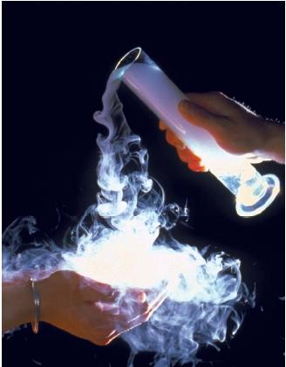
Gas

Slide 2
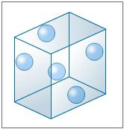
Properties of Gases
Molecules are far apart.
Indefinite volume
Indefinite shape
Can be compressed
Have mass.
Candle and Carbon Dioxide

Slide 3
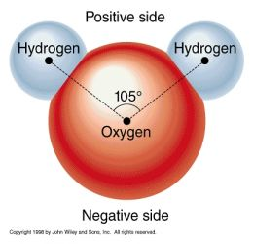
Kinetic Theory For Gases
Describes the behavior of gases by particle motion.
1. NO attractive forces between molecules.
H – H
nonpolar polar
Whenever two atoms of the same element bond together a nonpolar bond is formed.
The large oxygen atom has a stronger affinity for electrons than the small hydrogen atoms. Oxygen has a stronger pull on the bonding electrons, this leads to unequal sharing and the formation of a polar covalent bond.

Slide 4
Kinetic Theory For Gases
2. Negligible particle size
A gas is made of a large number of tiny particles which are so small their sizes are negligible compared to the average distances between them.
Most of the volume of a gas is just empty space.

Slide 5
Kinetic Theory For Gases
3. Particles are far apart.
Low Pressure vs. High Pressure

Slide 6
Kinetic Theory For Gases
4. Molecules move in random straight line motion.
Explains why gases have no definite shape, but expand to fill the volume of any container.

Slide 7
Kinetic Theory For Gases
5. Elastic collisions → No loss of energy
Gas molecules rebound after collisions, with no net loss of energy.

Slide 8
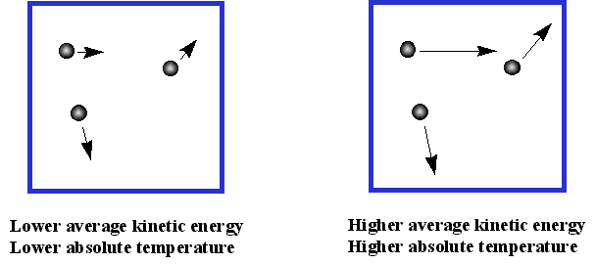
Conclusions:
Temperature is proportional to kinetic energy.

Slide 9
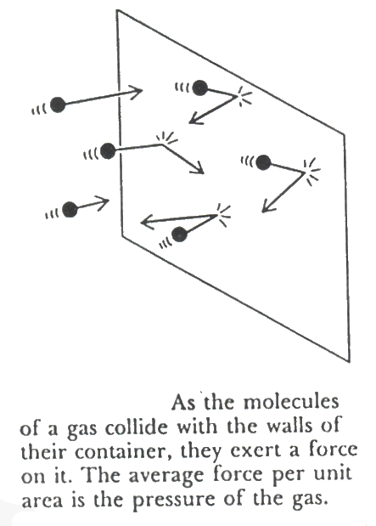
Conclusions
Pressure is proportional to the number of particle collisions with wall.

Slide 10
Conclusions
Volume occupied is the volume of the container.

Slide 11
Gas Laws
Pressure (P) → measured in kPa
What affects gas pressure?
Volume (V) → L
Temperature (T) → K
°C + 273 = K

Slide 12
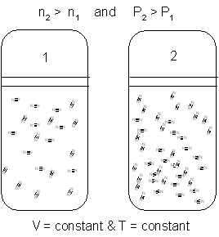
Gas Relationships
Particles Pressure
Direct or Proportional Relationship

Slide 13
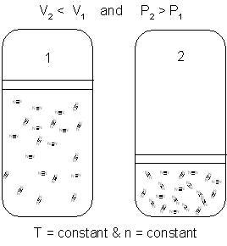
Gas Relationships
Volume Pressure
Indirect or Inverse Relationship

Slide 14
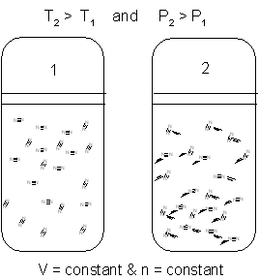
Gas Relationships
Temperature Pressure
Direct Relationship

Slide 15
Video Review
Kinetic Theory of Gases Review Video

