Slide 1
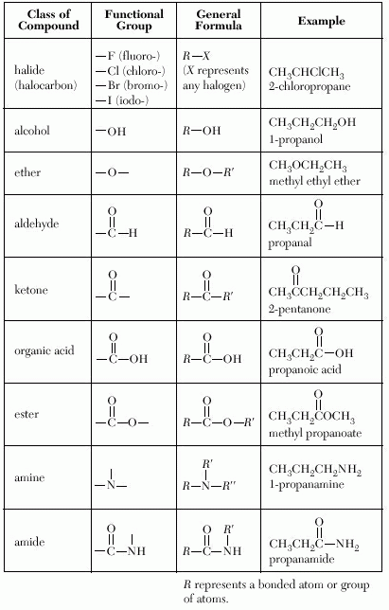
Functional Groups Continued
Table R

Slide 2
Ethers:

Slide 3
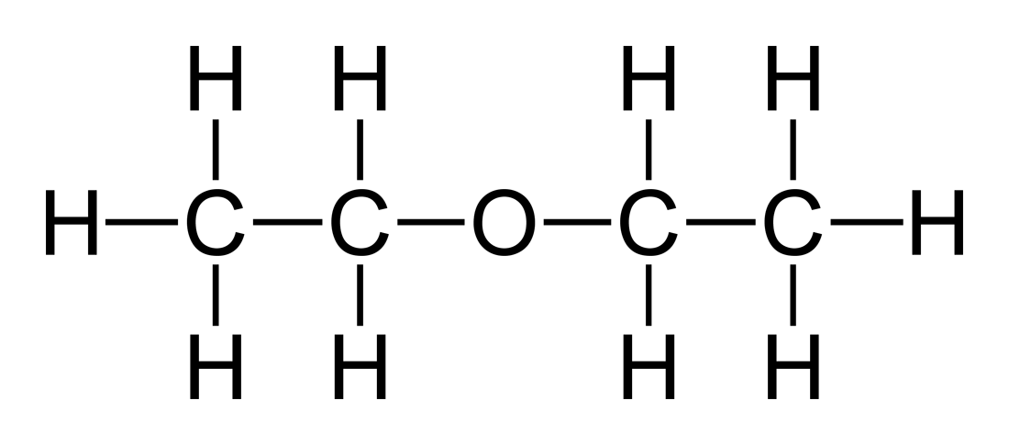
Ethers Continued:
Look at both sides of the – O –
If the same, use di and ether
If different, alphabetize and end with ether
diethylether

Slide 4
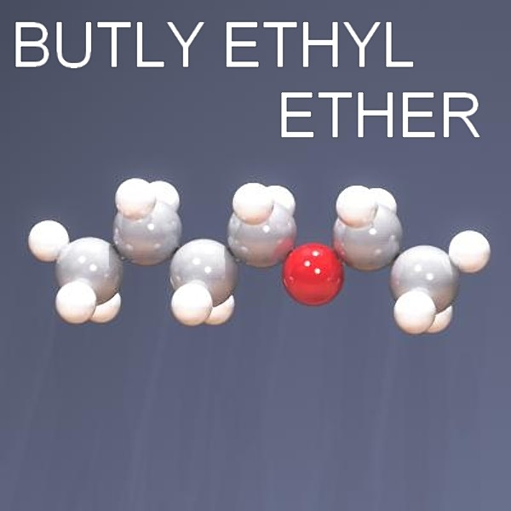
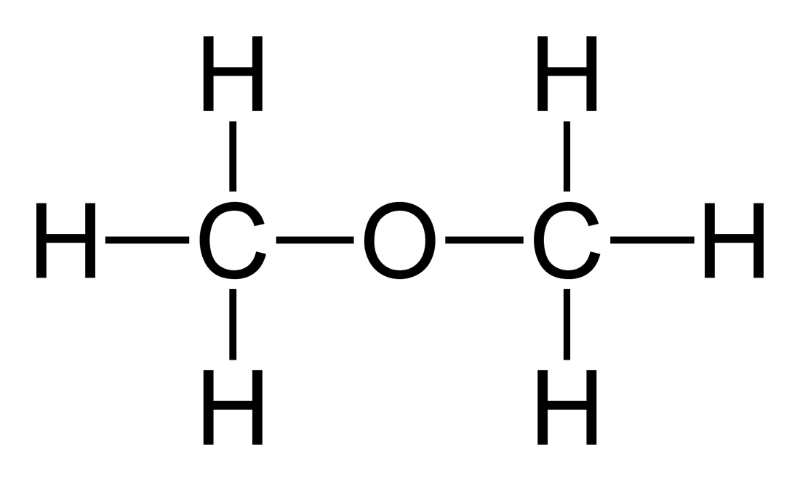
Ethers Continued:
butylethylether
C C O C C C C
ethylmethylether
dimethylether

Slide 5
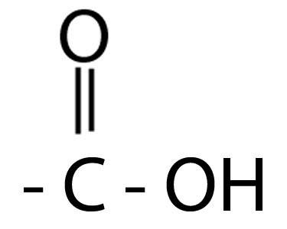
Organic Acids: -COOH
Functional Group
General Formula
* Drop the “e” add “oic” and “acid”

Slide 6
Organic Acids Continued:
O
Methanoic acid
H C OH
O
C C OH
Ethanoic acid
CH₃COOH (Table K)
Acetic Acid = Vinegar

Slide 7
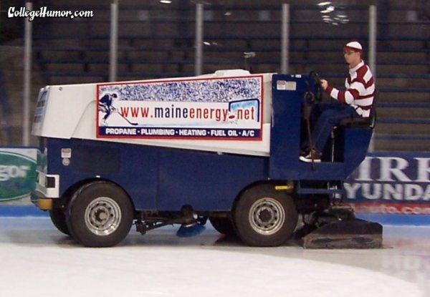
Esters:

Slide 8
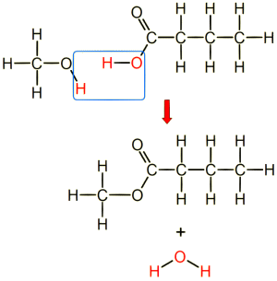
Esters Continued:
Organic Acid + Alcohol → Ester + Water

Slide 9
Esters Continued:
To name:
1. name alcohol side
2. name acid side ( ײ )
3. drop the “e” and add “oate”
O C
Acid
Alcohol
Methyl ethanoate

Slide 10
Amines:
* NH₂
* R – NH₂
* Drop the “e” and add “amine”
NH₂
C C C
1-propanamine

Slide 11
Amino acid = both acid group & amine group

Slide 12
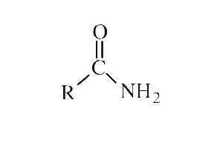
Amides:
* Drop the “e” and add “amide”
O
C C NH₂
ethanamide

