Slide 1
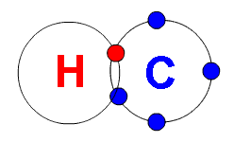
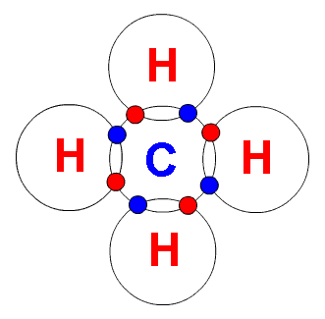
Hydrocarbons
*Compounds with just Hydrogen and Carbon

Slide 2
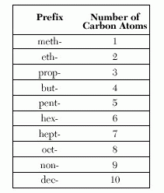
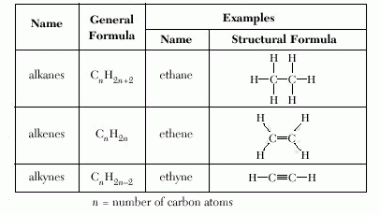
Reference Tables used with Organic Chemistry
Table P
Table Q

Slide 3
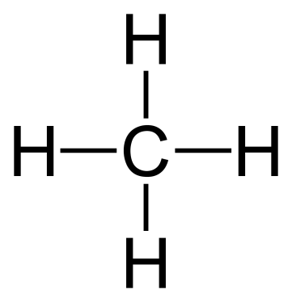
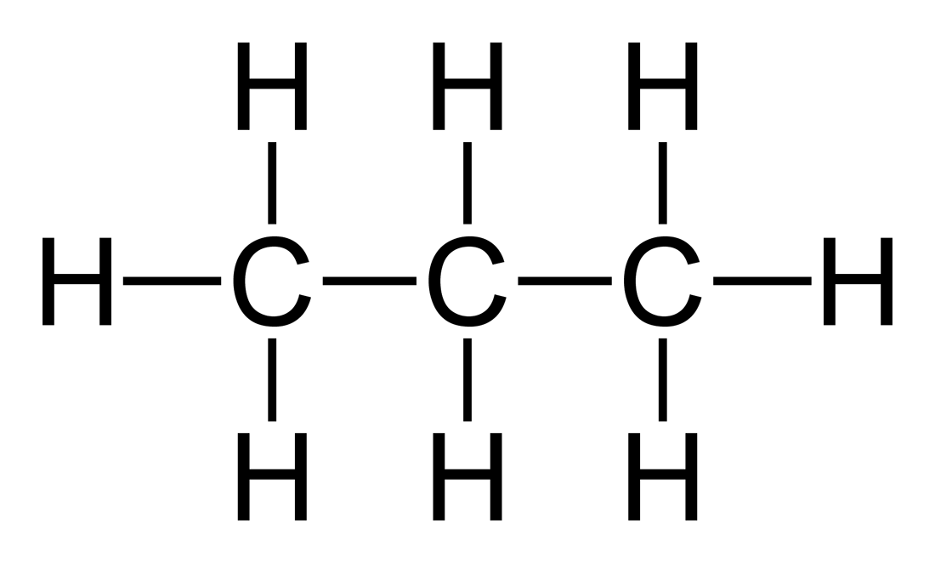
Types of Hydrocarbons:
Alkanes
*have single bonds between carbons
*end in “ane”
* formula = C_{n}H_{2n+2}
methane ethane propane

Slide 4
Branched Chain Alkanes
Need at least 4 carbons
Isomers: same molecular formula but different structural formulas
C₅H₁₂

Slide 5
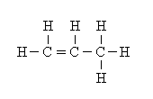
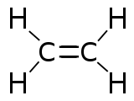
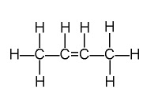
Types of Hydrocarbons:
Alkenes:
*have one double bond between carbons
*end in “ene”
* formula = C_{n}H_{2n}
ethene propene
1-butene 2-butene

Slide 6
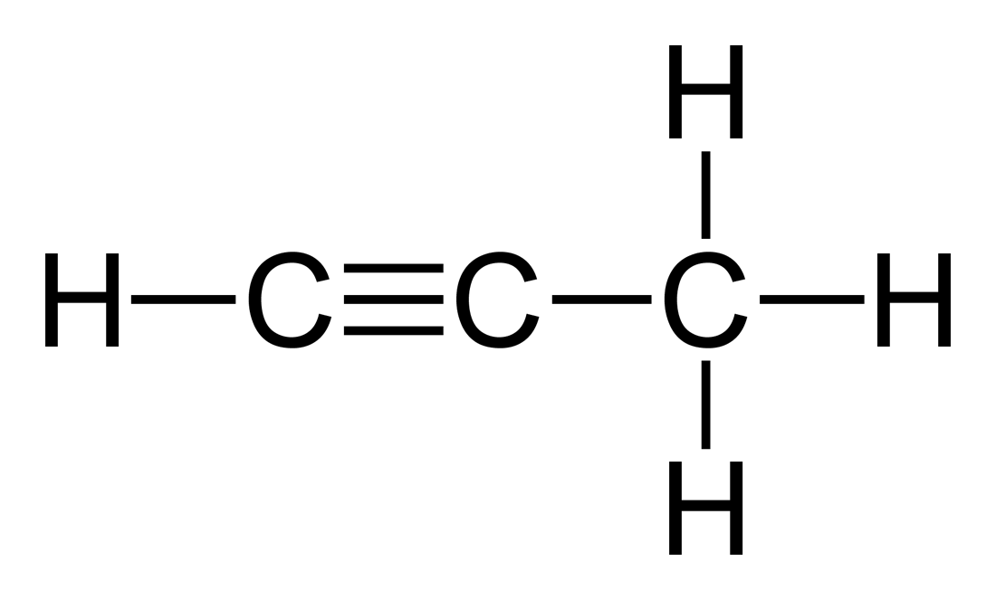
Types of Hydrocarbons:
3. Alkynes:
*have one triple bond between carbons
*end in “yne”
* formula = C_{n}H_{2n-2}
ethyne
propyne

Slide 7
Homologous Series:
A group of compounds that vary by a common increment
Table Q
ane = | Single bond
ene = | Double bond
yne = | Triple bond

Slide 8
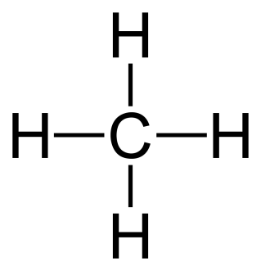
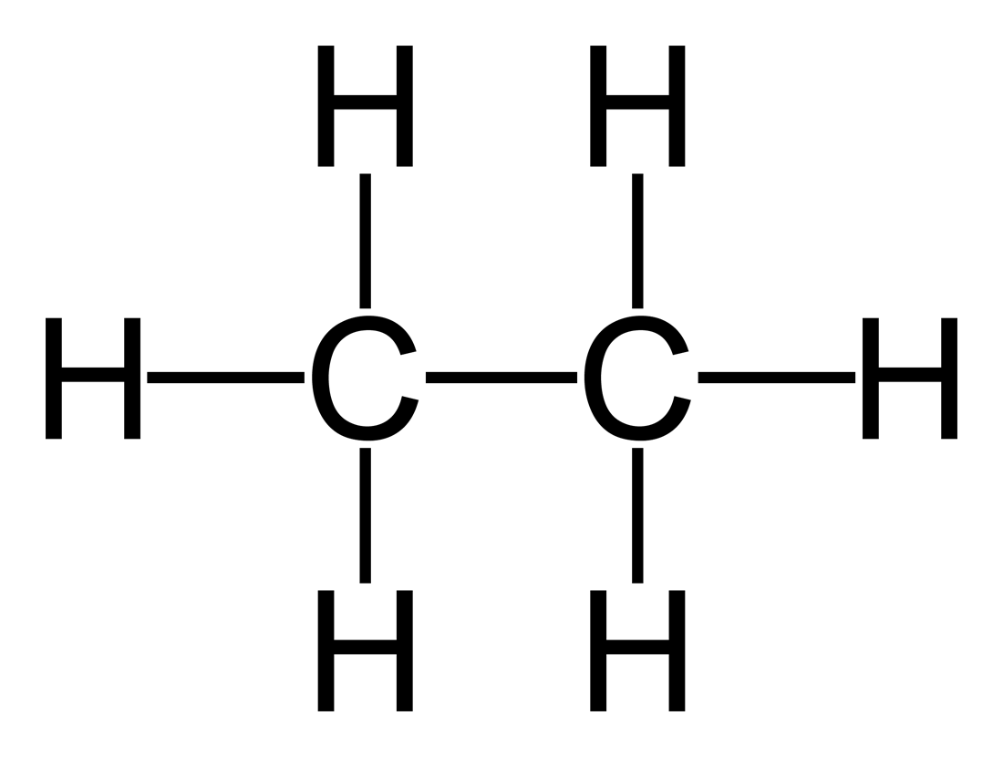
Derivatives of Hydrocarbons
One or more atoms replace Hydrogen in the hydrocarbon
Alkyl Group:
*an alkane with a missing Hydrogen
Methane CH₄
CH₃
Ethane C₂H₆
Ethyl C₂H₅

Slide 9
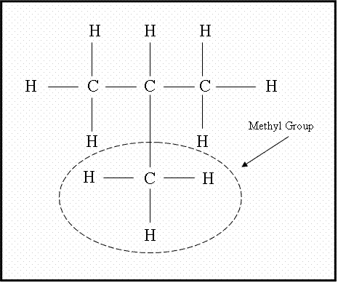
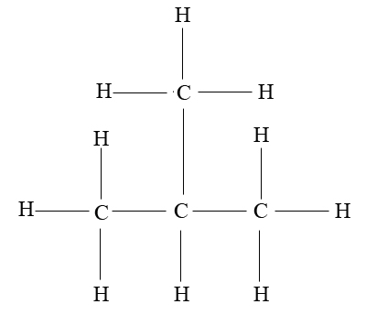
2-methyl propane

Slide 10
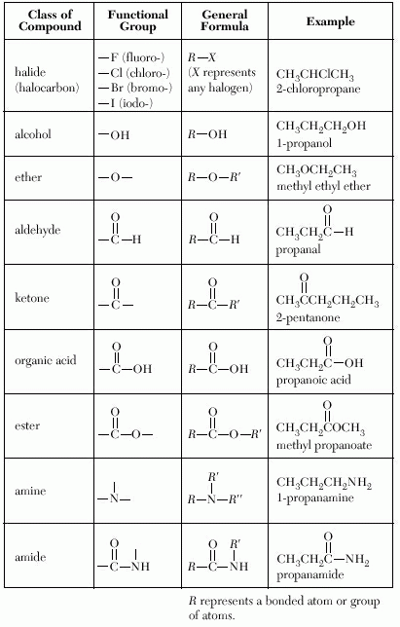
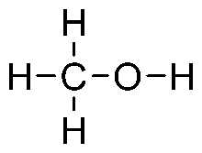
Derivatives of Hydrocarbons
Functional Group:
*a group of elements that determine the type of compound
Table R
Alcohol -
Base – NaOH not a functional group

