Slide 1
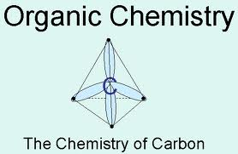
Introduction to Organic Chemistry

Slide 2
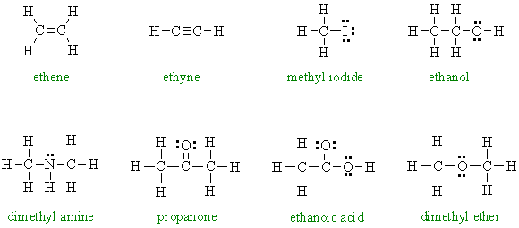
Carbon forms hundreds of thousands of compounds with Hydrogen. Carbon forms millions of other compounds.
The chemistry of Carbon is called organic chemistry.
An organic compound is one that has carbon as the principal element.

Slide 3
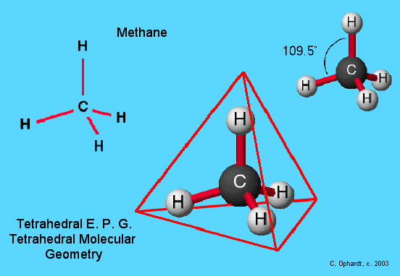
Carbon is unique:
It has 6 electrons = 1s²2s²2p²
It has room for 4 bonds to 4 other atoms.
Organic compounds have specific geometry around the carbon to carbon bond.
If there are four atoms or groups around a carbon atom, it has a tetrahedral geometry.

Slide 4
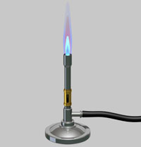
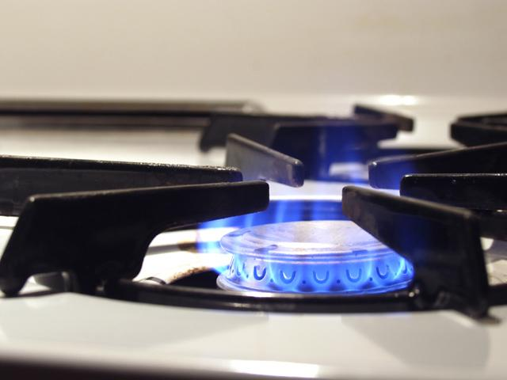
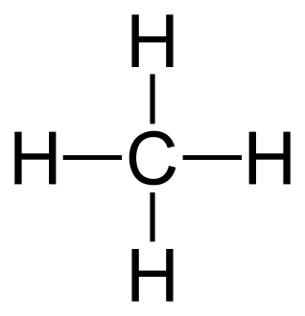
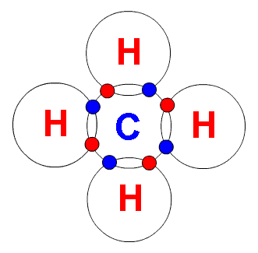
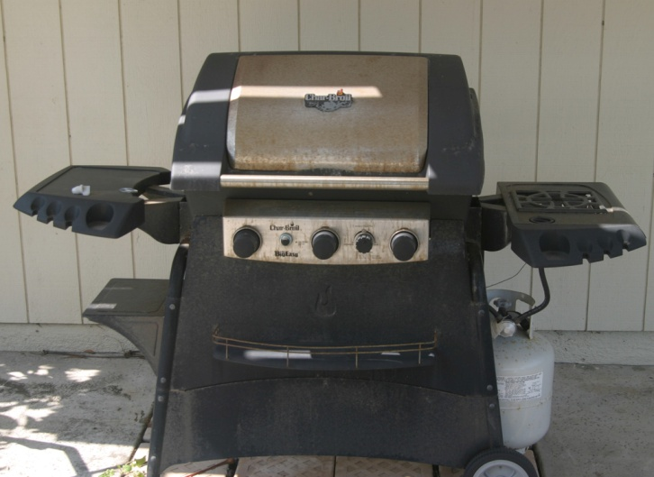
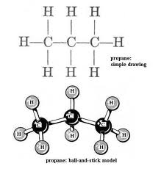
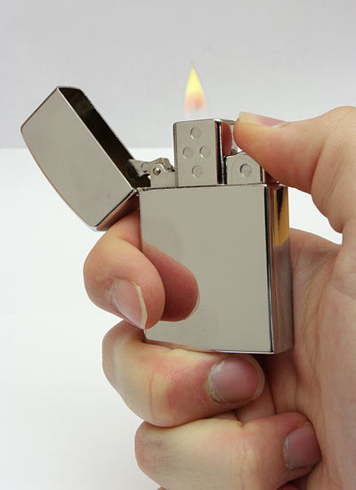
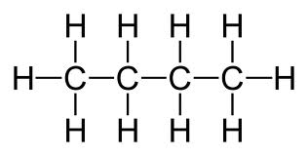
What gas is used in:
Bunsen burner and a
gas stove in your house?
Methane
Barbecue Grill?
Propane
Lighter?
Butane

Slide 5
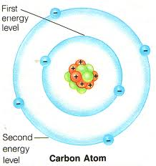
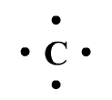
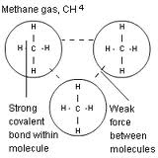
Properties:
Carbon has:
4 valence electrons
Carbon forms covalent bonds with weak intermolecular attractions
Low melting and boiling points
Not very soluble in water

Slide 6
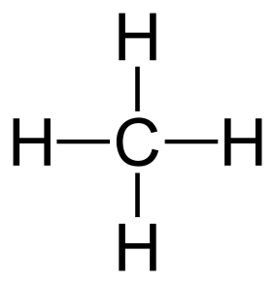
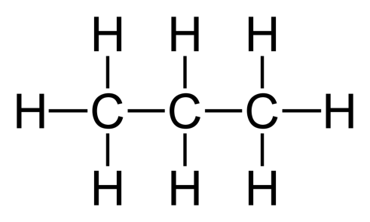
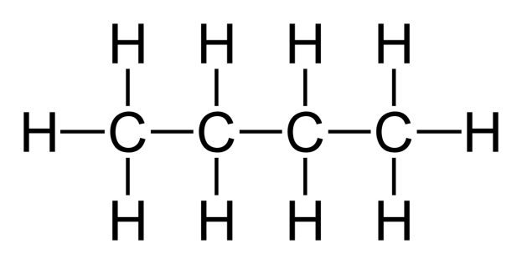
Methane (CH₄)
1 C = 6p+
6e-
Propane (C₃H₈)
3 C = 18p+
18e-
Butane (C₄H₁₀)
4 C = 24p+
24e-
Weak pull
Mild pull
Stronger pull
Boiling Pt.

Slide 7
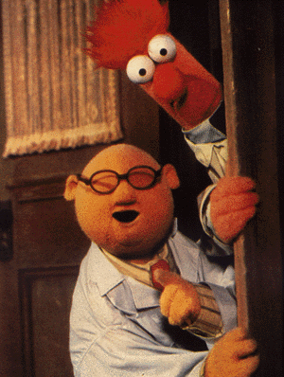
Chemical Properties:
Molecular compounds (covalent bonds) react more slowly than ionic.
Organic molecules undergo combustion
CH₄ + 0₂ → CO₂ + H₂O

Slide 8
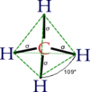
Structural Formulas:
Represent a 3D molecule in 2 dimensions
Structural
Formula
Tetrahedron

Slide 9
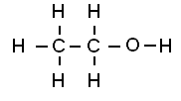
Condensed Structural Formulas:
CH₃(CH₂)₃CH₃
CH₃CH₂OH
CH₃CHO

